Slide 1
Program Planning a-z
Catherine Jardien, MA
Assistant Director for Student Life

Slide 2
objectives
Identify steps to planning programs at Stritch
After this session, you will be able to:
Plan a program/event at Stritch from start to finish
Book a room
Request Ed Tech and Housekeeping Services
Solicit funding
Order catering through Handcut Foods
Market through appropriate channels

Slide 3
General checklist
Pick a date
Plan your budget
Ask for funding (if you NEED it)
Clear any speakers
Book a room
Sketch room arrangement
Decide Ed Tech needs
Order food
Buy supplies
Market your event
Get reimbursed

Slide 4
Program request form
https://stritch.wufoo.com/forms/ztyxez818rp5nr/

Slide 5
Asking for funding
Decide which departments are most applicable
Ministry
Medical Education (Dr. Gruener)
Bioethics
CCGH
Diversity
Student Life
MSU
Be reasonable in your requests and expectations.
Do not make any purchases before funding has been approved.
Get approval for any purchases in writing to be sure you’ll be reimbursed.
When possible, have staff use their ProCards to make purchases.

Slide 6
Speaker Clearance
Fill out this form: https://stritch.wufoo.com/forms/m1mfytte1umd1pd/
Can be found on the SSOM Student Life website

Slide 7
Booking a Room
https://portal.luhs.org
Log in with your UVID (email)
Click on Room Scheduler
Schedule a Room OR Recurring Scheduler
Schedule a Room – best if you’re not sure which room you want
Recurring Scheduler – best if you know which room you want
List Catherine Jardien or Curtis Kimberlin as the Loyola contact person, especially if you’re booking a large space (atrium, lecture hall, etc.).

Slide 8
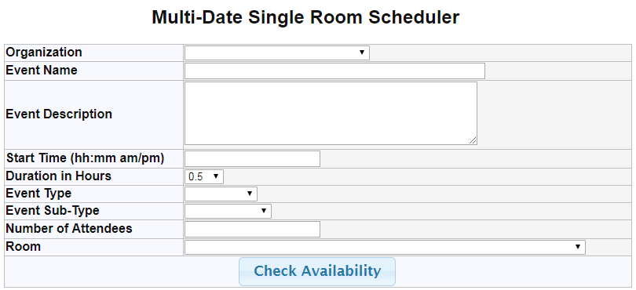
Recurring scheduler
Organization
SSOM Other
Event Sub-Type
Other

Slide 9
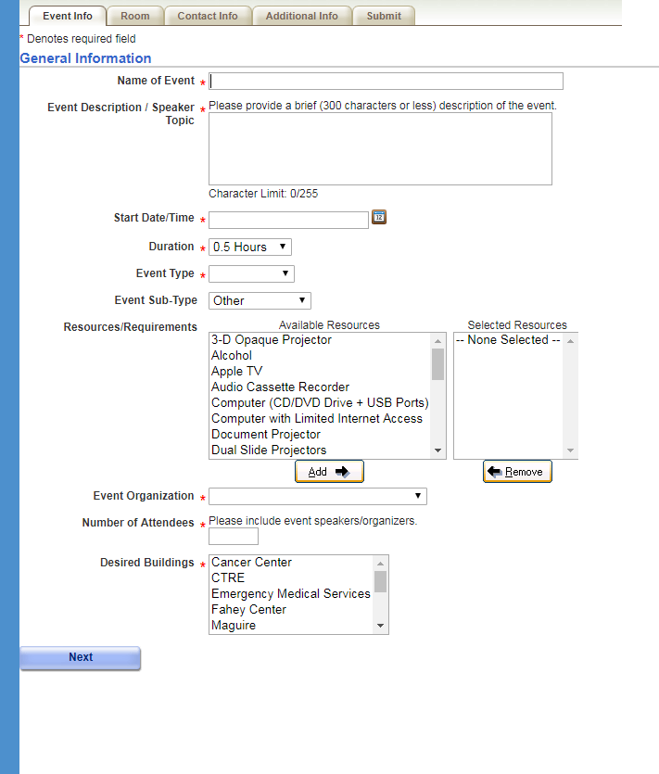
Schedule a room
Start Date/Time
The default time is the current time. Be sure to change that!
Resources/Requirements
Don’t need to fill this out.
Event Organization
SSOM Other

Slide 10
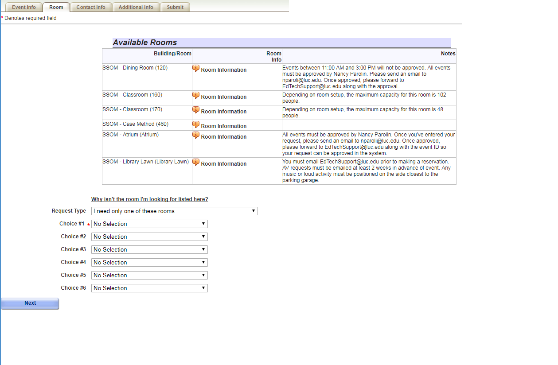
Schedule a room
Room Information
Shows you a photo of room
Why isn’t the room I’m looking for listed here?
Building Code for SSOM is 120
Ex. 120-360
(Stritch, room 360)

Slide 11
ROOMS that student life needs to book
Atrium
Leischner (390)
Tobin (190)
Fitness Center Lobby
Clinical Skills Center
Nursing School Lawn
CTRE*
Nursing Quiet Study Room*
Email: ssom-studentlife@luc.edu

Slide 12
facilities (Room Set-Up)
Things to consider
Do you want existing furniture to be arranged differently or new furniture to be added to the space? Or both?
Should existing furniture stay where it is, or be pushed to the side?
How many______ do you need? (tables, chairs, etc.)
What time do you need everything to be set up by?
What time should everything be taken down?
Furniture Available
6 foot buffet tables
Folding chairs
Podium
Research presentation boards
Stage (White Coat Ceremony)
Divider
Sketch it out

Slide 13
Ed Tech (Technology)
Equipment Available
Handheld microphones
Lavalier microphones
Microphones w/ stands
Speakers w/ aux cord (plugging in a phone/tablet)
iPad w/ Pandora subscription (music)
Streaming services
55” TV for presentations
Big screen w/projector
Laptops
iPads
Extension cords

Slide 14
handCut
Email Dominique Peyton, the catering manager at dominiquep@handcutfoods.com
If your event has alcohol, read the alcohol policy before requesting approval
Email Catherine or Curtis for approval

Slide 15
Buying Supplies
Get a tax exempt letter from Catherine or Curtis
ONLY USE IT WHEN YOU’RE BUYING SOMETHING FOR LOYOLA
Some places won’t accept it.
Hotels
Airlines
Some restaurants
Ask Catherine or Curtis to buy something on their ProCards
Things you can’t buy:
Alcohol
Gift cards
Lottery tickets/scratch-offs
Anything off Etsy or EBay (Amazon is okay)

Slide 16
Marketing your event
Email classes from your organization’s email account**
Ask Student Life to send out an email to all students from ssom-studentlife@luc.edu
Ask Ministry, CCGH, Bioethics, etc. to send email
Ask Student Life to email faculty and staff
Create and hang flyer
Use social media, especially Facebook class groups and Group Me’s!
Ask our Marketing Dept. to create a poster for you
Takes at least 2 weeks

Slide 17
Class email listservs
Stritch##@luc.edu (Class of 2021) = stritch21@luc.edu)
You can only use this list from your LUC email account.
Use for:
Campus events and program info
Student org info
Research opportunities
Academic correspondence
Do NOT use for:
Commercial interests
Soliciting support for causes/charities not associated with the university
Spam

Slide 18
EGR/CCGH credit
Ethics Grand Rounds Credit
Mark Kuczewski – mkuczew@luc.edu
Community and Global Health Credit
Lucia Garcia – lucgarcia@luc.edu

Slide 19
Getting Reimbursed
All reimbursements done with a check
Can take ~2-6 weeks to get processed
You must submit a reimbursement request within 30 days of spending the money
Things you can’t get reimbursed for
Taxes paid on a purchase
Interest charges you incur from putting something on a credit card
MSU Reimbursements
Handled through Teresa Cheng(next slide)
Non-MSU Reimbursements
Fill out a W-9 here: https://forms.luc.edu/w9/ (only needs to be done the first time you request reimbursement for the year)
Include the address where you’d like your reimbursement check sent
Bring ITEMIZED receipt to Curtis

Slide 20
Msu reimbursements
Handled through Teresa Cheng, MSU Treasurer
Every group allotted $100 for the year
Get tax exempt form from Teresa, Catherine, or Curtis
You CANNOT be reimbursed for tax paid
If spending under $100:
Fill out reimbursement form online here: https://stritch.wufoo.com/forms/mfb0wdr0p5x0uy/
You MUST upload an itemized receipt to the form, or email it directly to Curtis (ckimberlin@luc.edu). Reimbursement requests without a corresponding receipt will not be processed.
Reimbursement requests must be submitted within 30 days
Get your money ~2-6 weeks after processing

Slide 21
MSU Reimbursements
If you already spent the first $100 and need more:
Fill out the additional funding request Google form (on MSU website under Resrouces) BEFORE your event
Teresa will email you with confirmation and whether MSU approved your request
Then AFTER your event:
Fill out reimbursement form here: https://stritch.wufoo.com/forms/mfb0wdr0p5x0uy/
You MUST upload an itemized receipt to the form, or email it directly to Curtis (ckimberlin@luc.edu). Reimbursement requests without a receipt will not be processed.
Reimbursement requests must be submitted within 30 days
Get your money ~2-6 weeks after processing

Slide 22
Campus contact info
Event Planning
Handcut Foods
Dominique Peyton, Catering Manager – dominiquep@handcutfoods.com
Marketing
Naomi Gitlin, Executive Director of Marketing and Communication – ngitlin@luc.edu
Housekeeping
Loyola.hsd@ableserve.com
Ed Tech
EdTechSupport@luc.edu
University Departments
Student Life
Curtis Kimberlin, SL Coordinator – ckimberlin@luc.edu
Admissions
Latrice Williams, Admin. Asst. – lwilliams33@luc.edu
Office of Diversity, Equity, and Inclusion
Mark Torrez, Program Manager – mtorrez@luc.edu
Office of Bioethics
Robbin Hiller, Coordinator Bioethics Education – rhiller@luc.edu
Ministry
Ana Koulouris, Ministry Coordinator – akoulouris@luc.edu
Center for Community and Global Health
Lucia Garcia, Asst. Dir. – lucgarcia@luc.edu
Academic Center for Excellence
Tina Calcagno, Medical Education Coordinator – tcalcagno@luc.edu

Slide 23
Questions?
Email ssom-studentlife@luc.edu

